Slide 1
Market Basket Analysis
By
Dr. S PADMANABHAN

Slide 2
Market Basket Analysis
Market basket analysis is a data mining technique used by retailers to increase sales by better understanding customer purchasing patterns. It involves analyzing large data sets, such as purchase history, to reveal product groupings and products that are likely to be purchased together.
The adoption of market basket analysis was aided by the advent of electronic point-of-sale (POS) systems. Compared to handwritten records kept by store owners, the digital records generated by POS systems made it easier for applications to process and analyze large volumes of purchase data.

Slide 3
How does Market Basket Analysis Work?
Market Basket Analysis is modelled on Association rule mining, i.e., the IF {}, THEN {} construct. For example, IF a customer buys bread, THEN he is likely to buy butter as well.
Association rules are usually represented as: {Bread} -> {Butter}
Some terminologies to familiarize yourself with Market Basket Analysis are:
Antecedent: Items or 'itemsets' found within the data are antecedents. In simpler words, it's the IF component, written on the left-hand side. In the above example, bread is the antecedent.
Consequent: A consequent is an item or set of items found in combination with the antecedent. It's the THEN component, written on the right-hand side. In the above example, butter is the consequent.

Slide 4
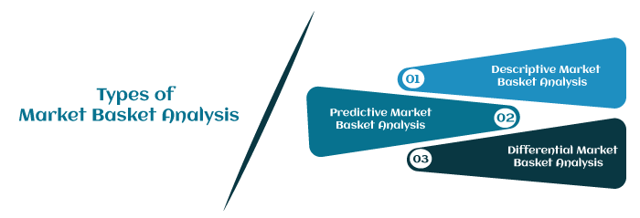
Types of Market Basket Analysis
Market Basket Analysis techniques can be categorized based on how the available data is utilized. Here are the following types of market basket analysis in data mining, such as:

Slide 5
1. Descriptive market basket analysis: This type only derives insights from past data and is the most frequently used approach. The analysis here does not make any predictions but rates the association between products using statistical techniques. For those familiar with the basics of Data Analysis, this type of modelling is known as unsupervised learning.
2. Predictive market basket analysis: This type uses supervised learning models like classification and regression. It essentially aims to mimic the market to analyze what causes what to happen. Essentially, it considers items purchased in a sequence to determine cross-selling. For example, buying an extended warranty is more likely to follow the purchase of an iPhone. While it isn't as widely used as a descriptive MBA, it is still a very valuable tool for marketers.

Slide 6
3. Differential market basket analysis: This type of analysis is beneficial for competitor analysis. It compares purchase history between stores, between seasons, between two time periods, between different days of the week, etc., to find interesting patterns in consumer behaviour. For example, it can help determine why some users prefer to purchase the same product at the same price on Amazon vs Flipkart. The answer can be that the Amazon reseller has more warehouses and can deliver faster, or maybe something more profound like user experience.

Slide 7
Algorithms associated with Market Basket Analysis
In market basket analysis, association rules are used to predict the likelihood of products being purchased together.
Association rules count the frequency of items that occur together, seeking to find associations that occur far more often than expected.
Algorithms that use association rules include AIS, SETM and Apriori.
The Apriori algorithm is commonly cited by data scientists in research articles about market basket analysis. It identifies frequent items in the database and then evaluates their frequency as the datasets are expanded to larger sizes.

Slide 8
With the help of the Apriori Algorithm, we can further classify and simplify the item sets that the consumer frequently buys.
There are three components in APRIORI ALGORITHM:
SUPPORT
CONFIDENCE
LIFT

Slide 9
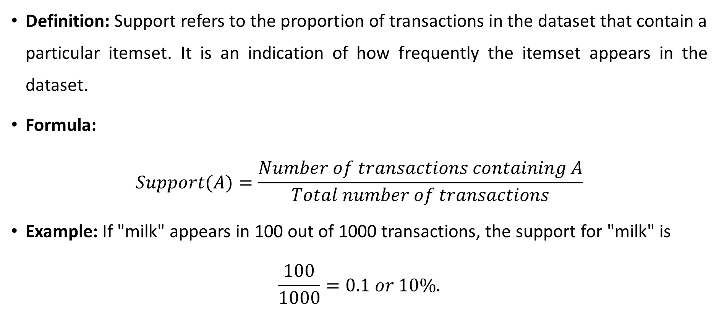
1. Support
Definition: Support refers to the proportion of transactions in the dataset that contain a particular itemset. It is an indication of how frequently the itemset appears in the dataset.
Formula: $Support(A)=\frac{Number of transactions containing A​}{Total number of transactions}$
Example: If "milk" appears in 100 out of 1000 transactions, the support for "milk" is
$$\frac{100}{1000}=0.1 or 10\%.$$

Slide 10
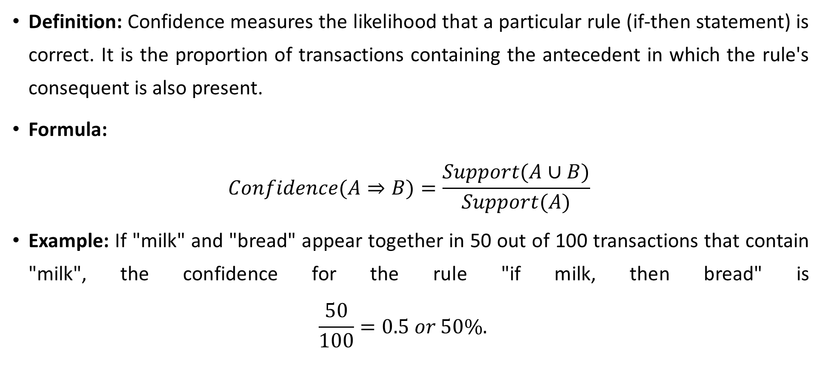
2. Confidence
Definition: Confidence measures the likelihood that a particular rule (if-then statement) is correct. It is the proportion of transactions containing the antecedent in which the rule's consequent is also present.
Formula: $Confidence(A⇒B)=\frac{Support(A∪B)}{Support(A)}​$
Example: If "milk" and "bread" appear together in 50 out of 100 transactions that contain "milk", the confidence for the rule "if milk, then bread" is $\frac{50}{100}=0.5 or 50\%.$

Slide 11
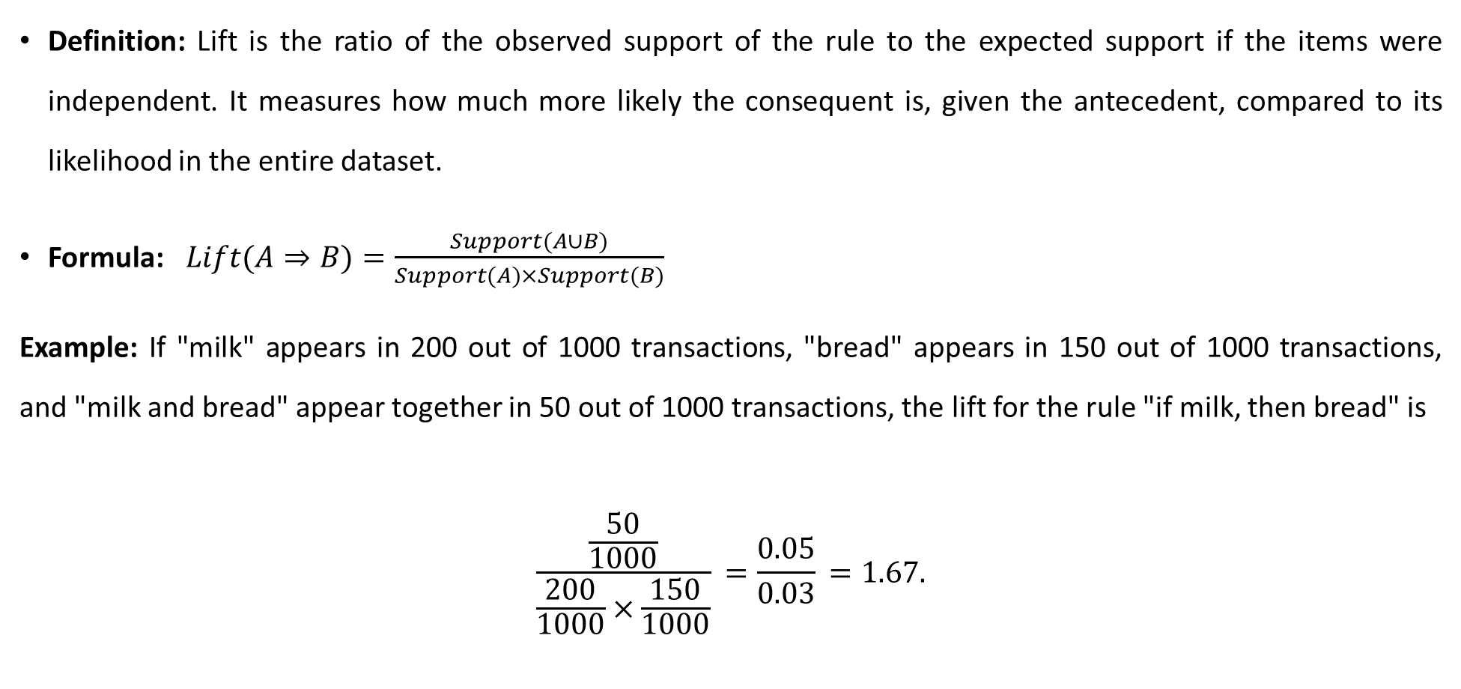
3. Lift
Definition: Lift is the ratio of the observed support of the rule to the expected support if the items were independent. It measures how much more likely the consequent is, given the antecedent, compared to its likelihood in the entire dataset.
Formula: $Lift(A⇒B)=\frac{Support(A∪B)}{Support(A)×Support(B)}$
Example: If "milk" appears in 200 out of 1000 transactions, "bread" appears in 150 out of 1000 transactions, and "milk and bread" appear together in 50 out of 1000 transactions, the lift for the rule "if milk, then bread" is
$$\frac{\frac{50}{1000}}{\frac{200}{1000}×\frac{150}{1000}}​​=\frac{0.05}{0.03}​=1.67.$$

Slide 12
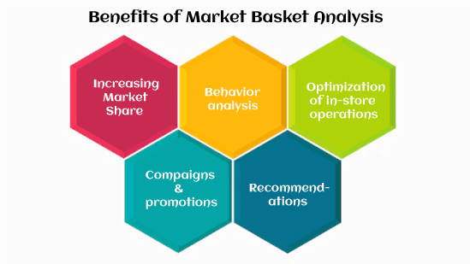
Benefits of Market Basket Analysis
The market basket analysis data mining technique has the following benefits, such as:

Slide 13
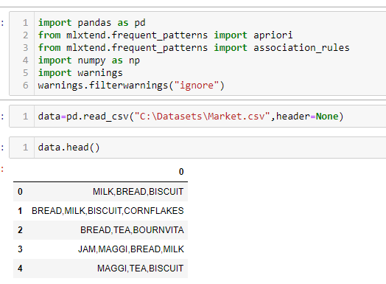
Python code - Apriori ML model (Market dataset)

Slide 14
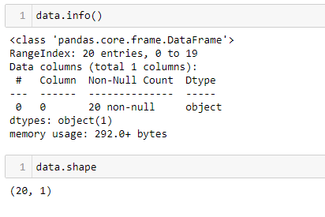

Slide 15
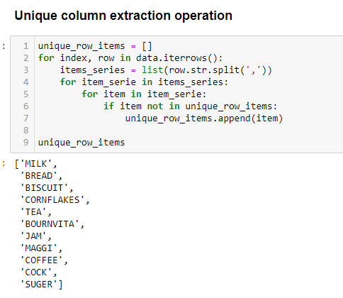

Slide 16
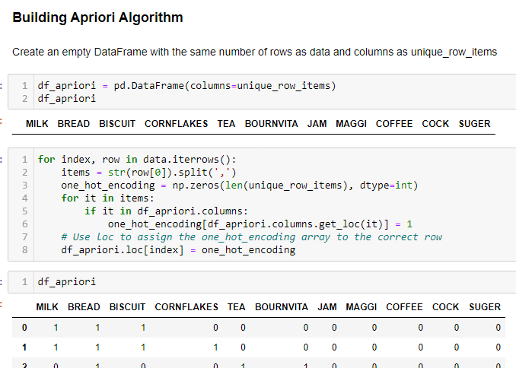

Slide 17
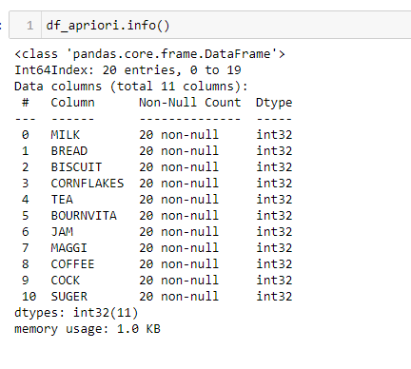

Slide 18
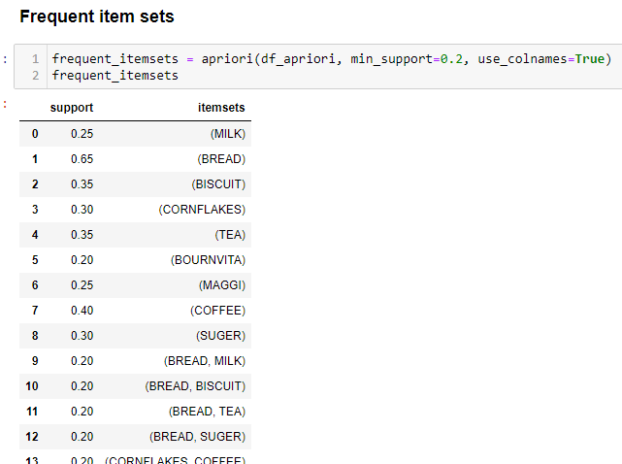

Slide 19
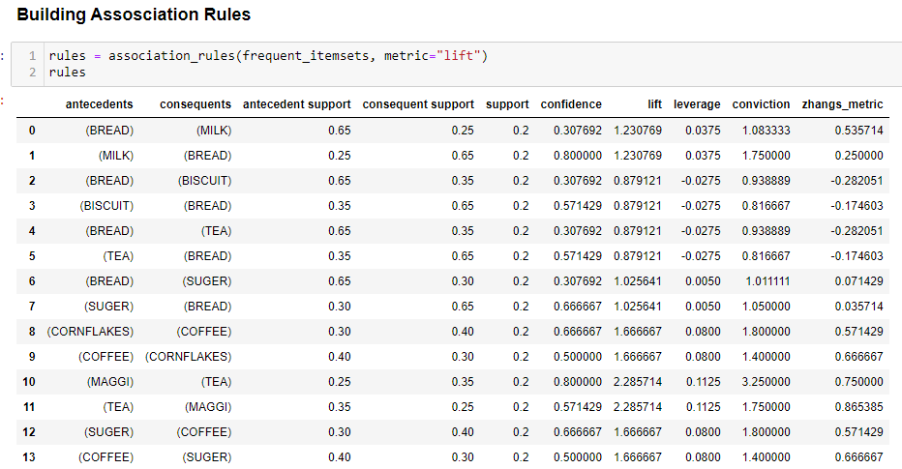

Slide 20
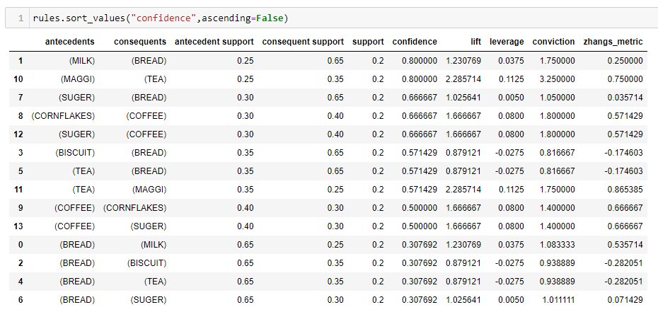

Slide 21
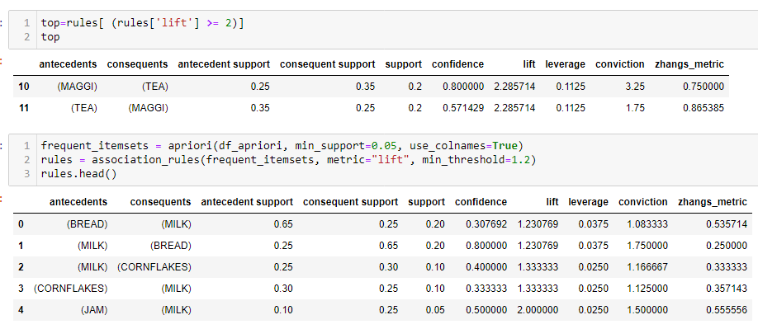

Slide 22
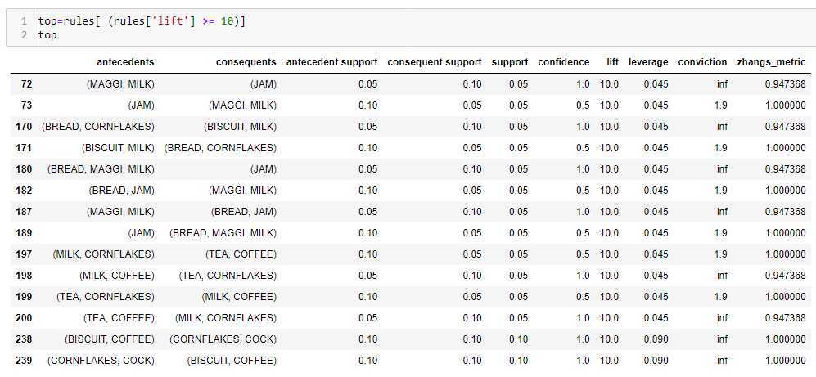

Slide 23
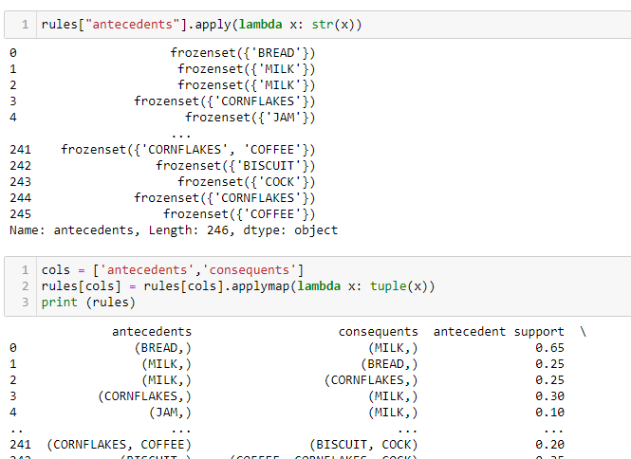

Slide 24
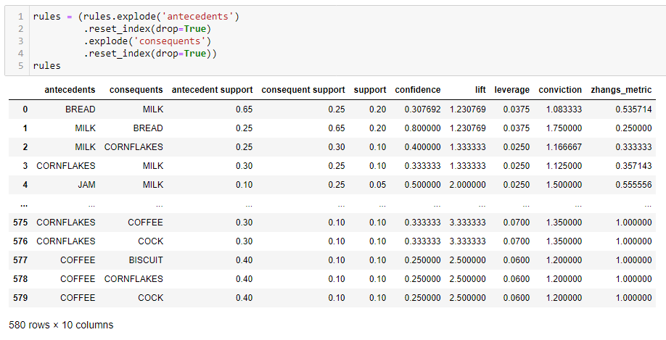

Slide 25
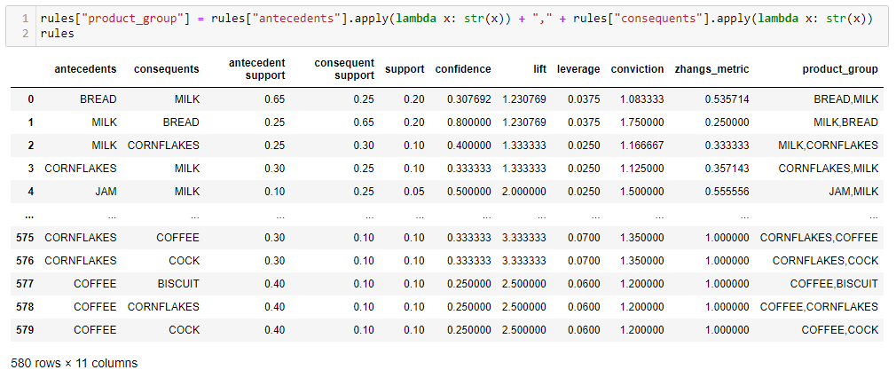

Slide 26
